Slide 1



COVID 19 DASHBOARD
View in Power BI
Last data refresh:
5/1/2020 8:14:13 PM India Standard Time
Downloaded at:
5/2/2020 8:03:18 PM India Standard Time

Slide 2
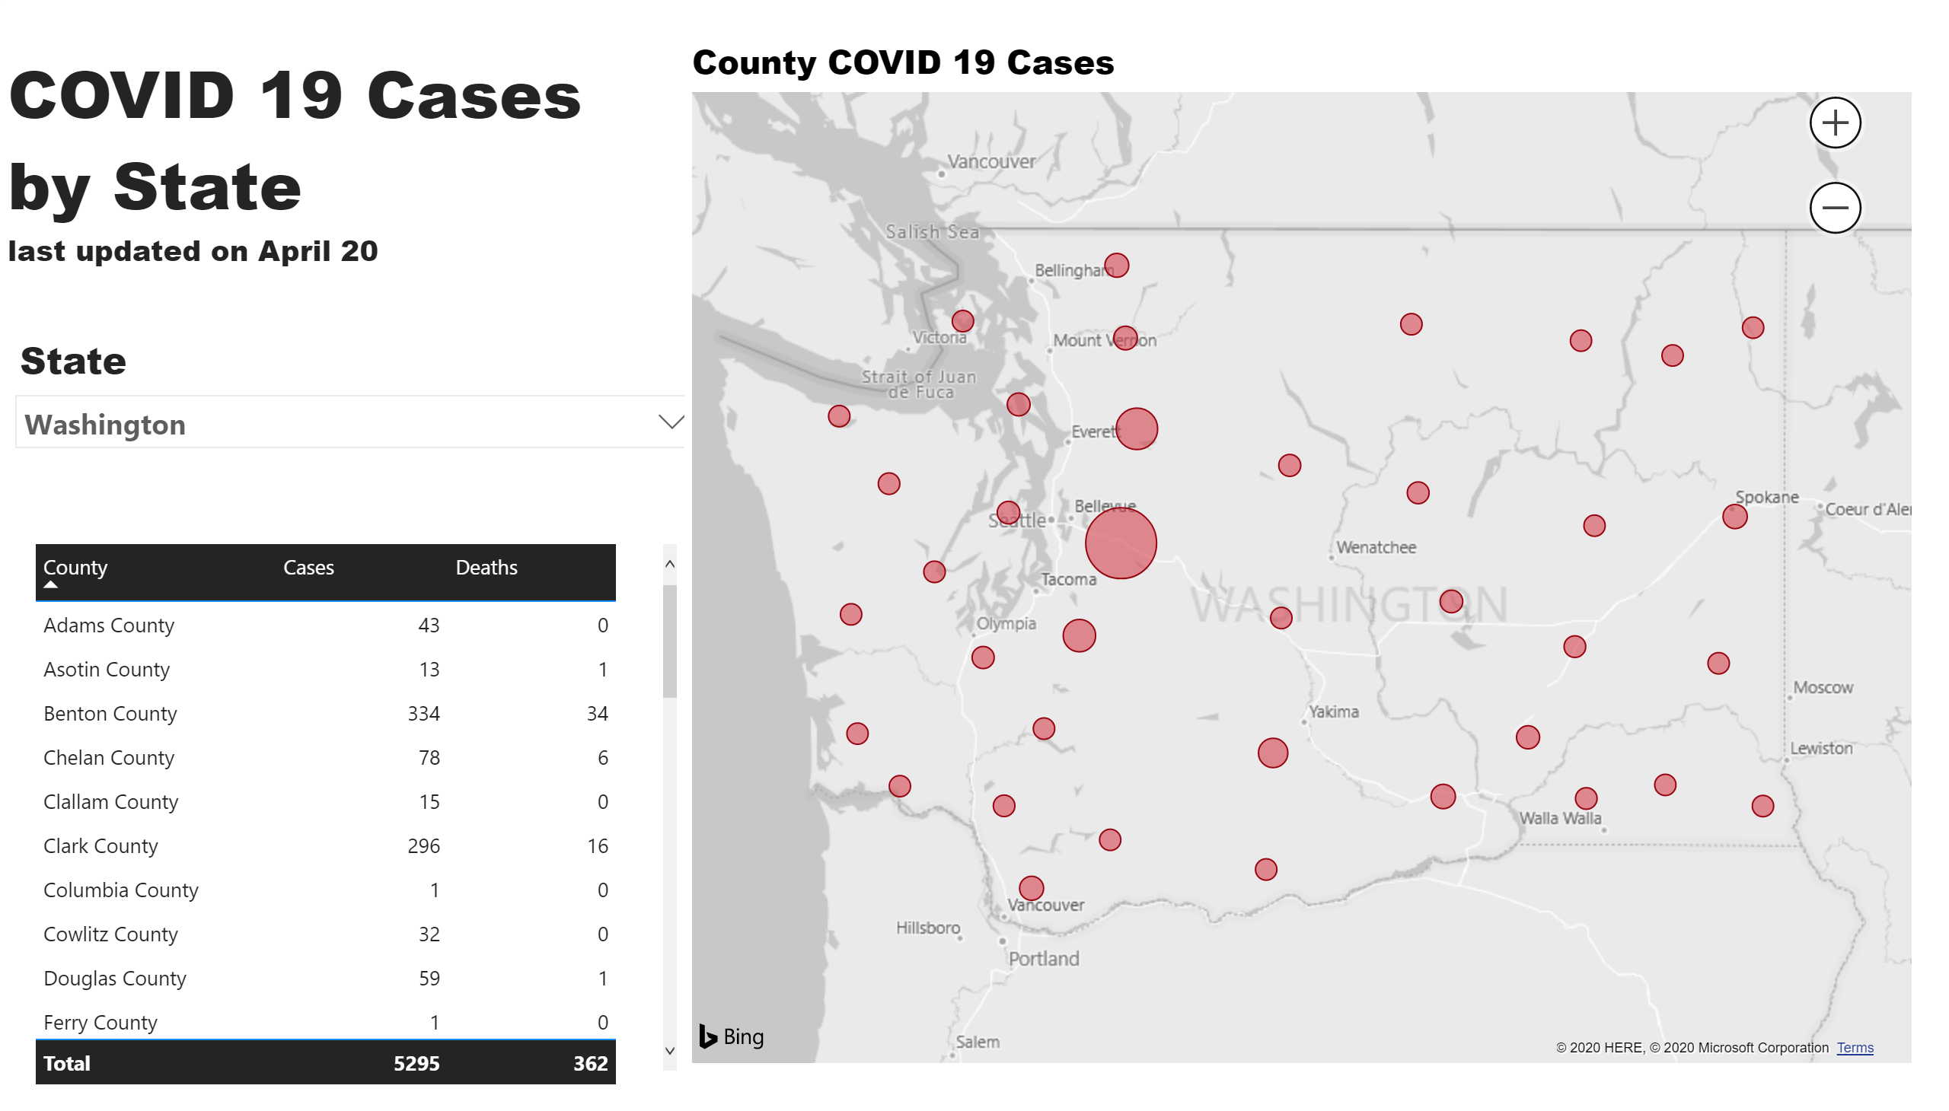

Slide 3
